Slide 1
Performance
Advanced Android Development
Lesson 4

Slide 2

4.3 Network, battery, compression

Slide 3
Contents
Network
Best practices
Optimizing images
Text data compression
Serializing data
Network Profiler tool
batterystats command
Battery Historian
WebP conversion

Slide 4
Network

Slide 5
Network for most users
Limited bandwidth
Expensive and limited (capped) data plans
Battery drain

Slide 6
Best practices
Optimize for low-speed or inconsistent connections, or no connection
Store data to do work offline
Resize images, optimize quality, choose best encoding
Reduce active radio time by optimizing the frequency of network requests and batching requests
Reduce size of data per request

Slide 7
Mobile radio
Inside your mobile device is a small piece of radio hardware
The whole purpose of this chip is to communicate with local cell towers and transmit data

Slide 8
Mobile radio has states
Not always active and drawing power
Starts in powered-down state
When data needs to be sent, turns on and transfers data
Once the packet is sent the radio chip stays awake for some time, in case there is a response from the server
Eventually, radio goes back to sleep to save battery

Slide 9
Typical 3G radio energy states
Full power: Connection active, allowing data transfer at highest possible rate
Low power: Uses ~50% less battery power
Standby: Minimal energy state when no network connection is active or required
Details vary for connection, carrier, and hardware

Slide 10
Latency versus power usage
Low and standby states drain a lot less battery but introduce significant latency
Returning to full power from low state takes ~1.5 seconds
Moving from standby to full can take over 2 seconds

Slide 11
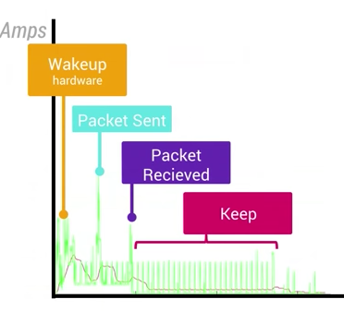
Requests, responses, and battery drain
Significant drain when radio wakes up (yellow)
Spikes when packets are sent and received (blue, purple)
Continuous draw for low power and standby states 20-30s (red)

Slide 12
Minimize power ups
Minimize the number of times the radio is powered up
Send as much data as you can per cycle
Get a server responses before it turns off
Requires some timing acrobatics
Several APIs available: JobScheduler, Firebase JobDispatcher

Slide 13
1st type of request: user action
Do now
User-initiated
Requires fast response
For example, logging in or requesting a photo
Not much to optimize

Slide 14
2nd type of request: server response
App makes request to the server and server sends response
Improve resource usage for request:
Reduce size of request and response…
...only ask for what you need
Compress data

Slide 15
3rd type of request: data push
Data push such as uploading analytics, saving state, or syncing
Optimize timing
Optimize size of received data

Slide 16
Network best practices

Slide 17
Never poll server for updates
An app that pings the server every 20 seconds keeps the radio powered on indefinitely
Use services such as Firebase Cloud Messaging, which allows the server to let your app know when new data is available

Slide 18
Do not oversync
Sync as often as you absolutely must, but no more
Ideally, sync when the device is on Wi-Fi and plugged in

Slide 19
Use back-off pattern
Use an exponential back-off pattern when you sync or poll to extend the time between subsequent polls
See Exponential backoff
Firebase Cloud Messaging will handle this for your app

Slide 20
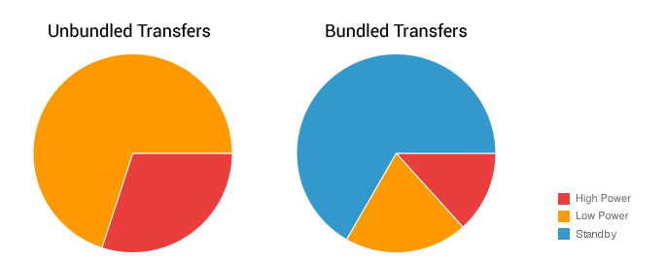
Bundle requests
JobScheduler API or Firebase JobDispatcher

Slide 21
Wait until user is on Wi-Fi
Defer non-immediate requests until user is on Wi-Fi and/or device is plugged in
Wi-Fi radio uses significantly less battery than wireless radio
See Modify your download patterns based on connectivity

Slide 22
Prefetch data
Try to predict what the user might need in the next few minutes and download it ahead of time with requested data
This requires some guessing, but if you predict correctly, you save battery power, and these small savings add up over time
For example the next song in album, or the full news article

Slide 23
Adapt to what user is doing
For example, if a user's phone has been immobile for 8 hours, then suddenly becomes active, it is possible they just woke up, and you can prefetch a batch of daily publications
If users are on Wi-Fi, sync their email while they are still on Wi-Fi, instead of when they are off Wi-Fi during their commute to work or school
There is no need to recheck stock prices when the market is closed!

Slide 24
Fetch text before media
Text requests tend to be smaller, compress better, and hence transfer faster, meaning that your app can display useful content quickly

Slide 25
Compress your data
In general, the amount of battery power the CPU uses to compress and decompress data is much less than the power used by the radio to transfer the same uncompressed data over the network

Slide 26
Make sure app works usefully offline
For example, let users compose messages when offline, and send them when they are connected

Slide 27
Store and cache data locally
Caching is turned off by default for Android apps
HttpResponseCache class enables caching of responses
Firebase Cloud Messaging with local storage
Local database to optimize performance regardless of network conditions

Slide 28
Offline-first architecture
Try to fetch data from local storage first. Failing that, request the data from network
Once retrieved from network, cache locally for future use
Make network requests for same data only once
Use local database for long-lived data (SQLite, SharedPreferences)

Slide 29
Adapt to available connectivity
Adapt to available connectivity
On slower connections, download only lower-resolution media, or none
Check for connectivity and network capabilities
User settings for syncing and data management
Fetch large data only if connected to a Wi-Fi network.
Prefetch data when device is connected to Wi-Fi

Slide 30
Use ConnectivityManager
ConnectivityManager > isActiveNetworkMetered()
ConnectivityManager > getActiveNetworkInfo()
ConnectivityManager > getNetworkCapabilities( Network network)
ConnectivityManager > getNetworkInfo(Network network)
TelephonyManager > getNetworkType()

Slide 31
Testing connectivity
ConnectivityManager cm = (ConnectivityManager)this
.getSystemService(Context.CONNECTIVITY_SERVICE);
NetworkInfo activeNetwork = cm.getActiveNetworkInfo();
boolean isConnected = activeNetwork != null &&
activeNetwork.isConnectedOrConnecting();
int connectionType = -1;
(continued on next slide)

Slide 32
Testing connectivity
if(isConnected) {
connectionType = activeNetwork.getType();
if (connectionType == ConnectivityManager.TYPE_WIFI) {
Log.d(DEBUG_TAG, "Mobile connected: to Wi-Fi");
} else if (connectionType == ConnectivityManager.TYPE_MOBILE) {
Log.d(DEBUG_TAG, "Mobile connected: to Cellular Network");
}
}
else{
Log.d(DEBUG_TAG, "Mobile connected: No active network connection");
}

Slide 33
Do you really need this data?
Do you really need this data?
The best way to save on networking performance is to not download or upload any data at all

Slide 34
Optimizing images

Slide 35

Optimize PNG images
Reduce number of unique colors and trade quality for size

Slide 36
Optimize JPG
Optimize JPG images
Adjust quality to around 75
Significantly smaller image size for insignificant visual difference
Many free tools available

Slide 37
Choose WebP when possible
Choose WebP when possible
WebP is an image file format from Google that provides lossy compression (like JPEG) as well as transparency (like PNG), but can provide better compression than either JPEG or PNG

Slide 38
Which format?
Do you support WebP?
Yes: Use WebP
No: Does the image need transparency?
Yes: Use PNG
No: Is the image "simple" in terms of colors, structure, or content?
Yes: Use PNG
No: JPG

Slide 39
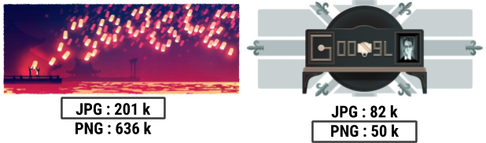
Details versus colors
Left: many small details, and compresses better with JPG
Right: runs of same color, compresses better with PNG

Slide 40
Best practices for loading images
Trade size and quality, it's a balancing act
Different resolutions for thumbnails and full screen
Use backend image service such as with Google App Engine
Request appropriate size
Adjust the quality that you request, depending on connectivity
Libraries such as Glide and Picasso simplify and optimize

Slide 41
Converting images to WebP

Slide 42
WebP support
Android has included lossy WebP support since Android 4.0 (API 14) and support for lossless, transparent WebP since Android 4.2 (API 18)
Conversion is in-place, meaning that your original image will be changed into the compressed image

Slide 43
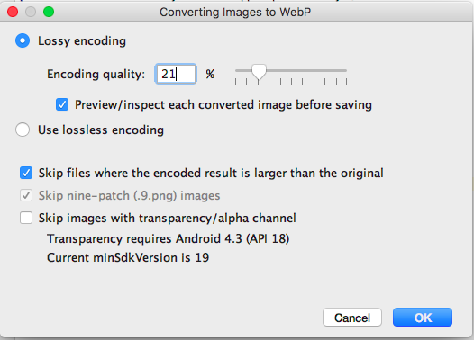
Convert images in Android Studio
In res/drawable:
Right-click image
Choose Convert to WebP
Converting Images to WebP dialog opens.
Choose params
Click OK for preview

Slide 44
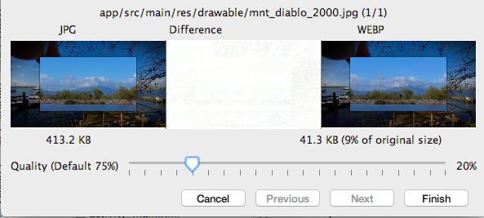
Preview and fine-tune
Fine-tune quality versus size
See immense saving with no noticeable quality loss
Click Finish

Slide 45
Text data compression

Slide 46
Checklist
Checklist
✔ Edit: smaller page, fewer words, only relevant content, multiple smaller pages
✔ Minify: CSS and JavaScript minifiers
✔ Compress: GZIP compression on server
✔ Offline compression using Zopfli or 7-Zip
See Text Compression for Web Developers

Slide 47
Serializing data

Slide 48
Serializing
Serializing
Structured data must be converted into a format that can be stored or sent over the network and used to reconstruct the original data and states at the destination
Common examples are JSON and XML, which are human readable but bulky and slow

Slide 49
FlatBuffers
FlatBuffers
With FlatBuffers you create a schema that describes your data and compiles it into source code that can serialize and deserialize your data. It's smaller, faster, and less painful.
See the Serialization with FlatBuffers video and the FlatBuffers documentation

Slide 50
Network Profiler tool

Slide 51
Network Profiler tool
Android Profiler includes Network Profiler
Track when your app is making network requests in real time
Monitor how and when your app transfers data
...so that you can reduce the frequency of data transfers
...and optimize data transferred during each connection

Slide 52
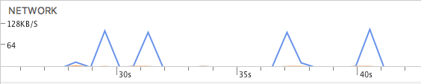
Starting Network Profiler
In Android Studio, open Android Profiler
View NETWORK graph
Click graph for detail view

Slide 53
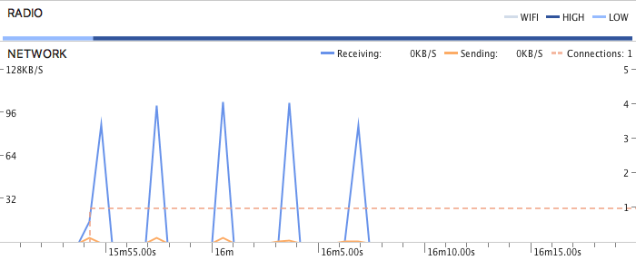
Network Profiler details
Orange spikes: data sent
Blue spikes: data received
x-axis moves in time
y-axis is transfer rate in kilobytes per second
Width of spike base is how long the request took
Height of spike is amount of data sent or received
Bar at the top shows power state

Slide 54
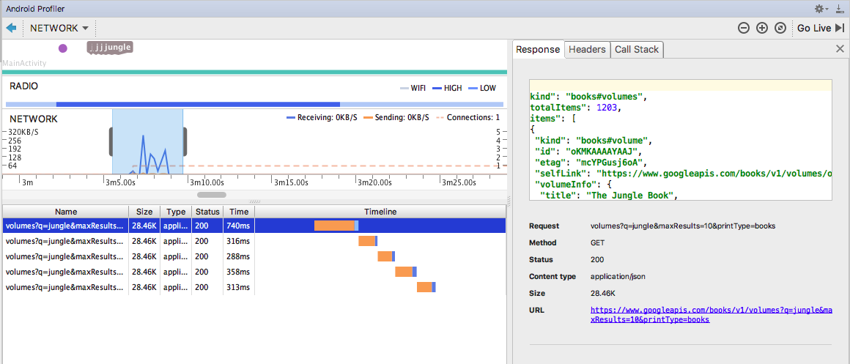
Network Profiler expanded
Response, Headers, Call Stack
Select graph section...
Response content
… for details

Slide 55
Batterystats and Battery Historian

Slide 56
batterystats & Battery Historian
Batterystats and Battery Historian
dumpsys batterystats collects power-related events from system logs of device
Battery Historian creates visualization that you can view in Chrome browser
Install Battery Historian from GitHub
(See README.md or the practical for instructions)

Slide 57
Get battery data
Reset battery logging to control amount of data: adb shell dumpsys batterystats --reset
Dump battery data and save output into a text file: adb shell dumpsys batterystats > batterystats.txt
Create report: adb bugreport bugreport.zip (7.0+) adb bugreport > bugreport.txt (6.0-)

Slide 58
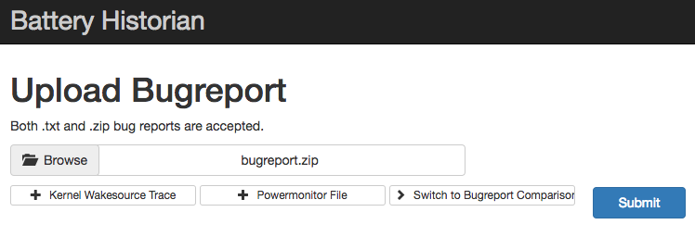
Open report in browser
Start Docker to run Battery Historian
Open tab in your browser
Upload bugreport.zip bugreport.txt
(See README.md or the practical for instructions)

Slide 59
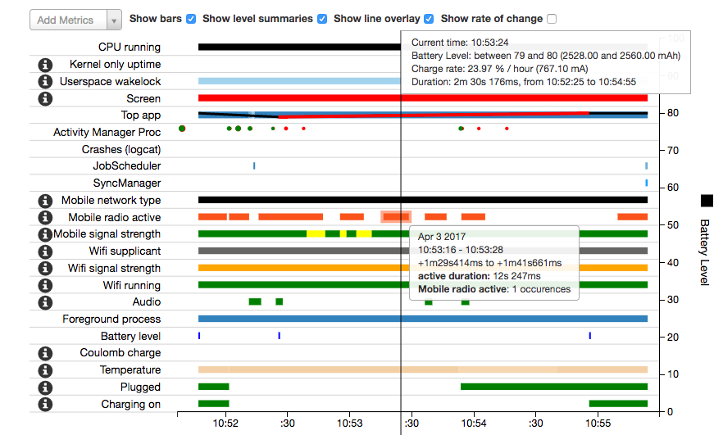

Slide 60
What's next?
Concept chapter: 4.3 Best practices: network, battery, compression
Practical: 4.3 Optimizing network, battery, and image use

Slide 61
END

